Slide 2
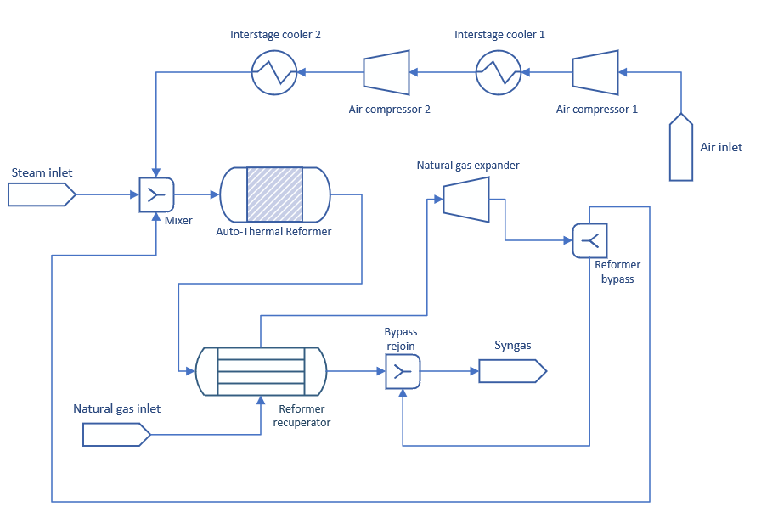
Full Space Flowsheet

Slide 3
ALAMO Flowsheet

Slide 4
ALAMO Flowsheet

Slide 5
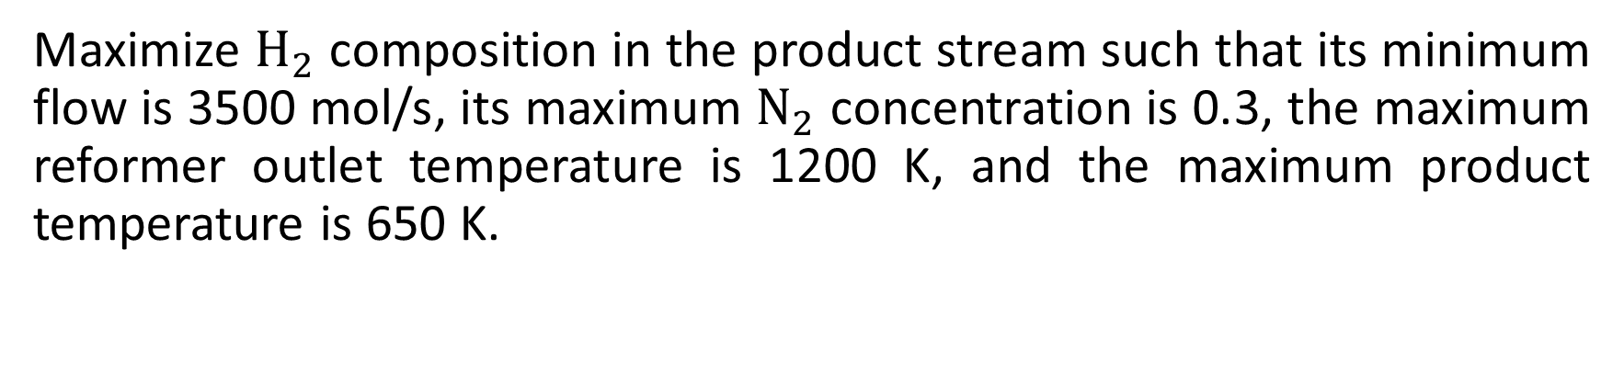
Optimization Problem
Maximize $H_{2}$ composition in the product stream such that its minimum flow is 3500 mol/s, its maximum $N_{2}$ concentration is 0.3, the maximum reformer outlet temperature is 1200 K, and the maximum product temperature is 650 K.

Slide 6
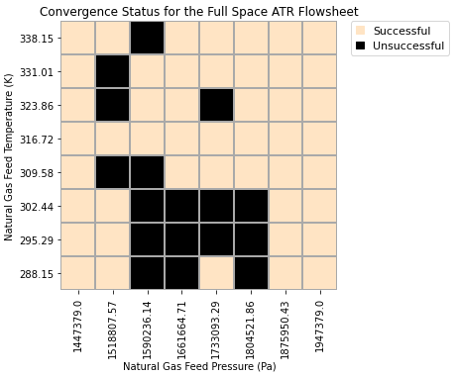
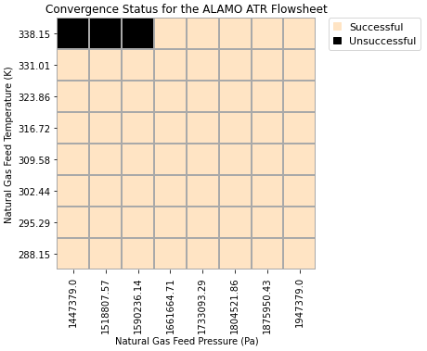
Convergence Status Plots

Slide 7
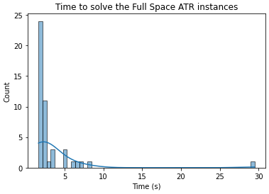
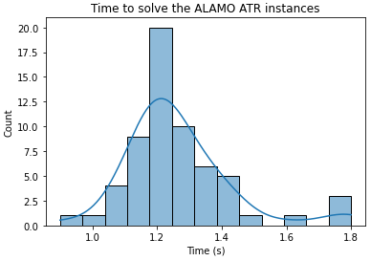
Performance Plots

Slide 8
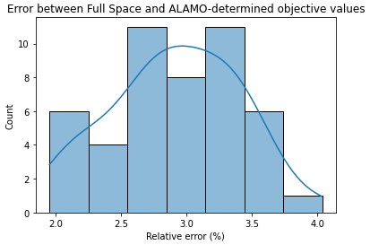
Error Plot

Slide 9
ALAMO Flowsheet Validation
For the instances where the Full Space Flowsheet did not converge:
How do we know that the solution given by the ALAMO ATR Flowsheet exists?
Solve a square Flowsheet with the values determined by the ALAMO ATR Flowsheet.

Slide 10
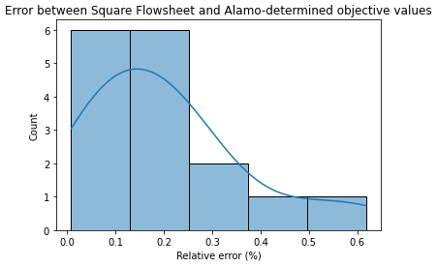
ALAMO Flowsheet Validation
The square system (inputs given by the ALAMO Flowsheet) converged in every instance where the Full Space formulation failed.

